Slide 1
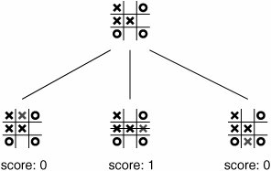


Tic Tac Toe with OpenCV and Dobot Magician
Cody Martin, Zac Clifton - Computer Science
Faculty Advisor: Suranga Hettiarachchi
Abstract
We develop a system, using Dobot Magician (robotic arm), Pixie2 (camera), and Python (program) to play Tic-Tac-Toe with a human player. The game completes when there are no more actions or one of the players reaches a win.
Methodology
Using OpenCV, if no motion is detected by the camera, we record current game state. The program differentiates between the former and current game state, and chooses an action to be carried out by the robot arm. The game logic uses an altered A.I. Algorithm Min/Max, using a heuristic value based on the possible outcomes of the game tree.
Conclusion
Introduction & Motivation
Our motivation for this project is to assist in the learning of Dobot Magician for young minds interested in the field of Robotics. Since Dobot Magician is not well documented as a programmable robot, we are determined to acquire information of the use of Dobot in this regard. We feel these motivations necessitate the use of Scientific Discovery.
Research Results
Diagrams
References
Clederson Cruz 2017, “tic-tac-toe-minimax“, Retrieved on 28 March 2019 from https://github.com/Cledersonbc/tic-tac-toe-minimax
Al Sweigart, “Chapter 10: Tic Tac Toe”, Retrieved on 30 March 2019 from https://inventwithpython.com/chapter10.html
Our algorithm takes the current state and tries all possible moves to find the best move from this state. The best move is found by a score that increase if the next possible state includes a win and vise versa if there is a loss.
Due to randomness in the first move placed by Dobot has still “won” 87% of the games it has played.

